Slide 1
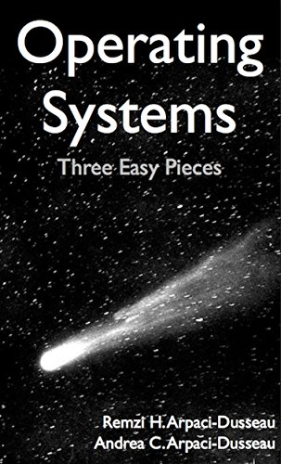
Computer Operating Systems BLG 312E Week-5
Prof. Dr. Kemal Bıçakcı

Slide 2
Review of Last Week

Slide 3
Review Question
Which one of these is not one of the programming errors made while using memory API?
a) Not allocating enough memory
b) Forgetting to initialize allocated memory
c) Forgetting to specify the size of memory to be freed
d) Freeing memory before you are done with it

Slide 4
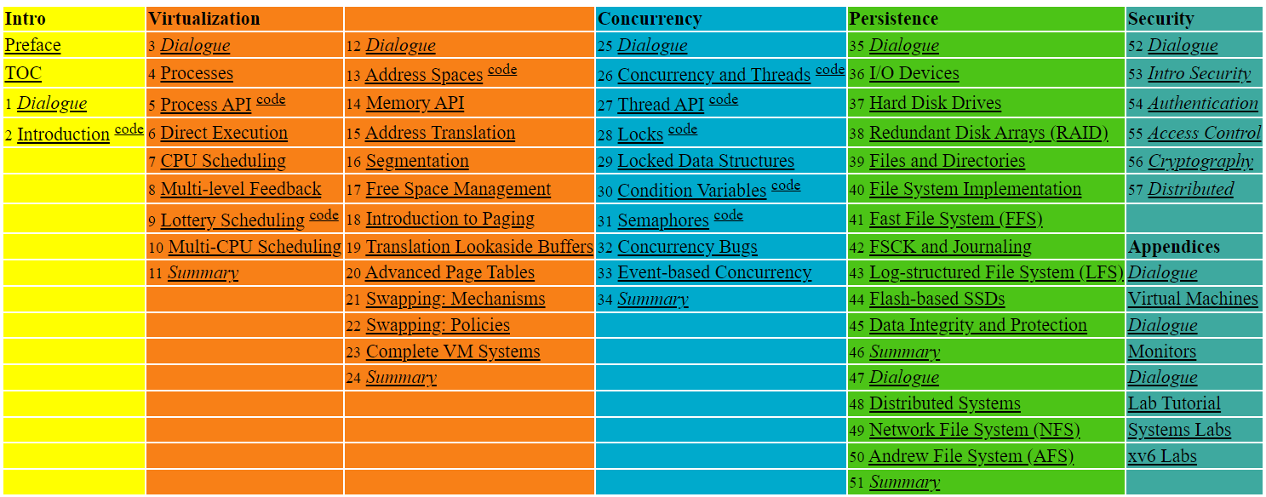

Slide 5
16. Segmentation
Operating System: Three Easy Pieces

Slide 6
Inefficiency of the Base and Bound Approach
0KB
Program Code
Big chunk of “free” space
“free” space takes up physical memory.
Hard to run when an address space does not fit into physical memory
1KB
2KB
3KB
4KB
5KB
Heap
6KB
(free)
14KB
15KB
Stack
16KB

Slide 7
Segmentation
Segment is just a contiguous portion of the address space of a particular length.
Logically-different segments: code, stack, heap
Each segment can be placed in different part of physical memory.
Base and bounds exist per each segment.

Slide 8
Placing Segment In Physical Memory
0KB
Operating System
16KB
(not in use)
Segment Base Size
Code 32K 2K
Heap 34K 2K
Stack 28K 2K
Stack
(not in use)
32KB
Code
Heap
(not in use)
48KB
64KB
Physical Memory

Slide 9
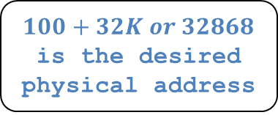
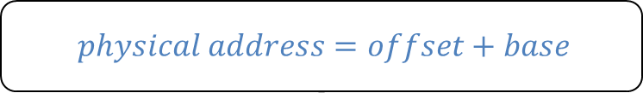
Address Translation on Segmentation
$$physical address=offset+base$$
The offset of virtual address 100 is 100.
The code segment starts at virtual address 0 in address space.
Segment Base Size
Code 32K 2K
16KB
(not in use)
0KB
32KB
$100+32K or 32868$ is the desired physical address
100
Program Code
Code
instruction
2KB
34KB
Heap
4KB
(not in use)

Slide 10
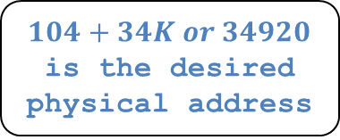
Address Translation on Segmentation (Cont’d)
$Virtual address+base$ is not the correct physical address.
The offset of virtual address 4200 is 104.
The heap segment starts at virtual address 4096 in address space.
Segment Base Size
Heap 34K 2K
(not in use)
32KB
Code
4KB
34KB
$104+34K or 34920$ is the desired physical address
4200
Heap
Heap
data
6KB
36KB
(not in use)
Address Space
Physical Memory

Slide 11
Segmentation Fault or Violation
If an illegal address such as 7KB which is beyond the end of heap is referenced, the OS occurs segmentation fault.
The hardware detects that address is out of bounds.
4KB
Heap
6KB
7KB
(not in use)
8KB
Address Space

Slide 12
Referring to Segment
Explicit approach
Chop up the address space into segments based on the top few bits of virtual address.
Example: virtual address 4200 (01000001101000)
13
12
11
10
9
8
7
6
5
4
3
2
1
0
Segment
Offset
13
12
11
10
9
8
7
6
5
4
3
2
1
0
Segment bits
Code 00
Heap 01
Stack 10
- 11
0
1
0
0
0
0
0
1
1
0
1
0
0
0
Segment
Offset

Slide 13
Referring to Segment (Cont.)
1 // get top 2 bits of 14-bit VA
2 Segment = (VirtualAddress & SEG_MASK) >> SEG_SHIFT
3 // now get offset
4 Offset = VirtualAddress & OFFSET_MASK
5 if (Offset >= Bounds[Segment])
6 RaiseException(PROTECTION_FAULT)
7 else
8 PhysAddr = Base[Segment] + Offset
9 Register = AccessMemory(PhysAddr)
SEG_MASK = 0x3000(11000000000000)
SEG_SHIFT = 12
OFFSET_MASK = 0xFFF (00111111111111)

Slide 14
Referring to Stack Segment
Stack grows backward.
Extra hardware support is need.
The hardware checks which way the segment grows.
1: positive direction, 0: negative direction
Segment Register (with Negative-Growth Support)
(not in use)
Segment Base Size Grows Positive?
Code 32K 2K 1
Heap 34K 2K 1
Stack 28K 2K 0
26KB
Stack
28KB
(not in use)
Physical Memory

Slide 15
Support for Sharing
Segment can be shared between address space.
Code sharing is still in use in systems today.
by extra hardware support.
Extra hardware support is needed in the form of Protection bits.
A few more bits per segment to indicate permissions of read, write and execute.
Segment Register Values(with Protection)
Segment Base Size Grows Positive? Protection
Code 32K 2K 1 Read-Execute
Heap 34K 2K 1 Read-Write
Stack 28K 2K 0 Read-Write

Slide 16
Fine-Grained and Coarse-Grained
Coarse-Grained means segmentation in a small number.
e.g., code, heap, stack.
Fine-Grained segmentation allows more flexibility for address space in some early system.
To support many segments, Hardware support with a segment table is required.

Slide 17
OS support: Fragmentation
External Fragmentation: little holes of free space in physical memory that make difficulty to allocate new segments.
There is 24KB free, but not in one contiguous segment.
The OS cannot satisfy the 20KB request.
Compaction: rearranging the exiting segments in physical memory.
Compaction is costly.
Stop running process.
Copy data to somewhere.
Change segment register value.

Slide 18
Memory Compaction
Not compacted
Compacted
0KB
Operating System
0KB
Operating System
8KB
8KB
16KB
16KB
(not in use)
Allocated
24KB
24KB
Allocated
32KB
32KB
(not in use)
40KB
Allocated
40KB
(not in use)
48KB
(not in use)
48KB
56KB
56KB
Allocated
64KB
64KB

Slide 19
17. Free-Space Management
Operating System: Three Easy Pieces

Slide 20
Splitting
Finding a free chunk of memory that can satisfy the request and splitting it into two.
When request for memory allocation is smaller than the size of free chunks.
30-byte heap:
free
used
free
0
10
20
30
addr:0
len:10
addr:20
len:10
free list:
head
NULL

Slide 21

Splitting (Cont.)
30-byte heap:
free
used
free
0
10
20
30
Two 10-bytes free segment with 1-byte request
addr:0
len:10
addr:20
len:10
free list:
head
NULL
$$splitting 10byte free segment$$
30-byte heap:
free
used
free
0
10
20 21
30
addr:0
len:10
addr:21
len:9
free list:
head
NULL

Slide 22

Coalescing
If a user requests memory that is bigger than free chunk size, the list will not find such a free chunk.
Coalescing: Merge returning a free chunk with existing chunks into a large single free chunk if addresses of them are nearby.
addr:10
len:10
addr:0
Len:10
addr:20
len:10
head
NULL
$$coalescing free chunks$$
addr:0
len:30
head
NULL

Slide 23
Tracking The Size of Allocated Regions
The interface to free(void *ptr) does not take a size parameter.
How does the library know the size of memory region that will be back into free list?
Most allocators store extra information in a header block.
ptr = malloc(20);
The header used by malloc library
ptr
The 20 bytes returned to caller
An Allocated Region Plus Header

Slide 24
The Header of Allocated Memory Chunk
The header minimally contains the size of the allocated memory region.
The header may also contain
Additional pointers to speed up deallocation
A magic number for integrity checking
hptr
size: 20
magic: 1234567
typedef struct __header_t {
int size;
int magic;
} header_t;
ptr
The 20 bytes
returned to caller
A Simple Header
Specific Contents Of The Header

Slide 25
The Header of Allocated Memory Chunk (Cont.)
The size for free region is the size of the header plus the size of the space allocated to the user.
If a user request N bytes, the library searches for a free chunk of size N plus the size of the header
Simple pointer arithmetic to find the header pointer.
void free(void *ptr) {
header_t *hptr = (void *)ptr – sizeof(header_t);
}

Slide 26
Embedding A Free List
The memory-allocation library initializes the heap and puts the first element of the free list in the free space.
The library can’t use malloc() to build a list within itself.

Slide 27
Embedding A Free List (Cont.)
Description of a node of the list
Building heap and putting a free list
Assume that the heap is built via mmap() system call.
typedef struct __node_t {
int size;
struct __node_t *next;
} nodet_t;
// mmap() returns a pointer to a chunk of free space
node_t *head = mmap(NULL, 4096, PROT_READ|PROT_WRITE, MAP_ANON|MAP_PRIVATE, -1, 0);
head->size = 4096 - sizeof(node_t);
head->next = NULL;

Slide 28
A Heap With One Free Chunk
// mmap() returns a pointer to a chunk of free space
node_t *head = mmap(NULL, 4096, PROT_READ|PROT_WRITE, MAP_ANON|MAP_PRIVATE, -1, 0);
head->size = 4096 - sizeof(node_t);
head->next = NULL;
[virtual address: 16KB]
header: size field
size: 4088
head
next: 0
header: next field(NULL is 0)
■ ■ ■
the rest of the 4KB chunk

Slide 29
Embedding A Free List: Allocation
If a chunk of memory is requested, the library will first find a chunk that is large enough to accommodate the request.
The library will
Split the large free chunk into two.
One for the request and the remaining free chunk
Shrink the size of free chunk in the list.

Slide 30
Embedding A Free List: Allocation (Cont.)
Example: a request for 100 bytes by ptr = malloc(100)
Allocating 108 bytes out of the existing one free chunk.
shrinking the one free chunk to 3980(4088 minus 108).
A 4KB Heap With One Free Chunk
A Heap : After One Allocation
head
size: 100
size: 4088
next: 0
magic: 1234567
ptr
the rest of
the 4KB chunk
■ ■ ■
the 100 bytes now allocated
■ ■ ■
head
size: 3980
next: 0
■ ■ ■
the free 3980 byte chunk

Slide 31
Free Space With Chunks Allocated
size: 100
[virtual address: 16KB]
8 bytes header
magic: 1234567
■ ■ ■
100 bytes still allocated
size: 100
sptr
magic: 1234567
■ ■ ■
100 bytes still allocated
(but about to be freed)
size: 100
magic: 1234567
■ ■ ■
100 bytes still allocated
head
size: 3764
next: 0
■ ■ ■
The free 3764-byte chunk
Free Space With Three Chunks Allocated

Slide 32
Free Space With free()
Example: free(sptr)
[virtual address: 16KB]
size: 100
magic: 1234567
The 100 bytes chunks is back into the free list.
The free list will start with a small chunk.
The list header will point the small chunk
■ ■ ■
100 bytes still allocated
head
size: 100
sptr
next: 16708
(now a free chunk of
memory)
■ ■ ■
size: 100
magic: 1234567
■ ■ ■
100 bytes still allocated
size: 3764
next: 0
■ ■ ■
The free 3764-byte chunk

Slide 33
Free Space With Freed Chunks
Let’s assume that the last two in-use chunks are freed.
External Fragmentation occurs.
Coalescing is needed in the list.
[virtual address: 16KB]
size: 100
next: 16492
■ ■ ■
(now free)
size: 100
next: 16708
■ ■ ■
(now free)
head
size: 100
next: 16384
■ ■ ■
(now free)
size: 3764
next: 0
■ ■ ■
The free 3764-byte chunk

Slide 34
Growing The Heap
Most allocators start with a small-sized heap and then request more memory from the OS when they run out.
e.g., sbrk(), brk() in most UNIX systems.
(not in use)
(not in use)
Heap
Heap
Heap
Heap
(not in use)
break
sbrk()
(not in use)
break
Address Space
Address Space
Heap
Physical Memory

Slide 35
Managing Free Space: Basic Strategies
Best Fit:
Finding free chunks that are big or bigger than the request
Returning the one of smallest in the chunks in the group of candidates
Worst Fit:
Finding the largest free chunks and allocation the amount of the request
Keeping the remaining chunk on the free list.

Slide 36
Managing Free Space: Basic Strategies (Cont.)
First Fit:
Finding the first chunk that is big enough for the request
Returning the requested amount and remaining the rest of the chunk.
Next Fit:
Finding the first chunk that is big enough for the request.
Searching at where one was looking at instead of the begging of the list.

Slide 37
Examples of Basic Strategies
10
30
20
head
NULL
Allocation Request Size 15
Result of Best-fit
Result of Worst-fit
10
30
5
head
NULL
10
15
20
head
NULL

Slide 38
Other Approaches: Segregated List
Segregated List:
Keeping free chunks in different size in a separate list for the size of popular request.
New Complication:
How much memory should dedicate to the pool of memory that serves specialized requests of a given size?
Slab allocator handles this issue.

Slide 39
Other Approaches: Segregated List (Cont.)
Slab Allocator
Allocate a number of object caches.
The objects are likely to e requested frequently.
e.g., locks, file-system inodes, etc.
Request some memory from a more general memory allocator when a given cache is running low on free space.

Slide 40
Other Approaches: Buddy Allocation
Binary Buddy Allocation
The allocator divides free space by two until a block that is big enough to accommodate the request is found.
64 KB
32 KB
32 KB
16 KB
16 KB
8 KB
8 KB
64KB free space for 7KB request

Slide 41
Other Approaches: Buddy Allocation (Cont.)
Buddy allocation can suffer from internal fragmentation.
Buddy system makes coalescing simple.
Coalescing two blocks in to the next level of block.

Slide 42
18. Paging: Introduction
Operating System: Three Easy Pieces

Slide 43
Concept of Paging
Paging splits up address space into fixed-sized units each called a page.
Segmentation: variable size of logical segments(code, stack, heap, etc.)
With paging, physical memory is also split into some number of pages called a page frame.
Page table per process is needed to translate the virtual address to physical address.

Slide 44
Advantages Of Paging
Flexibility: Supporting the abstraction of address space effectively
Don’t need assumption how heap and stack grow and are used.
Simplicity: ease of free-space management
The page in address space and the page frame are the same size.
Easy to allocate and keep a free list

Slide 45
Example: A Simple Paging
128-byte physical memory with 16 bytes page frames
64-byte address space with 16 bytes pages
0
page frame 0 of physical memory
reserved for OS
16
(unused)
page frame 1
0
32
(page 0 of the address space)
page 3 of AS
page frame 2
16
48
(page 1)
page 0 of AS
page frame 3
32
64
(page 2)
(unused)
page frame 4
48
(page 3)
80
page 2 of AS
page frame 5
64
A Simple 64-byte Address Space
96
(unused)
page frame 6
112
page 1 of AS
page frame 7
128
64-Byte Address Space Placed In Physical Memory

Slide 46
Address Translation
Two components in the virtual address
VPN: virtual page number
Offset: offset within the page
Example: virtual address 21 in 64-byte address space
VPN
offset
Va5
Va4
Va3
Va2
Va1
Va0
VPN
offset
0
1
0
1
0
1

Slide 47
Example: Address Translation
The virtual address 21 in 64-byte address space
VPN
offset
Virtual
Address
0
1
0
1
0
1
Address Translation
Physical
Address
1
1
1
0
1
0
1
PFN
offset

Slide 48
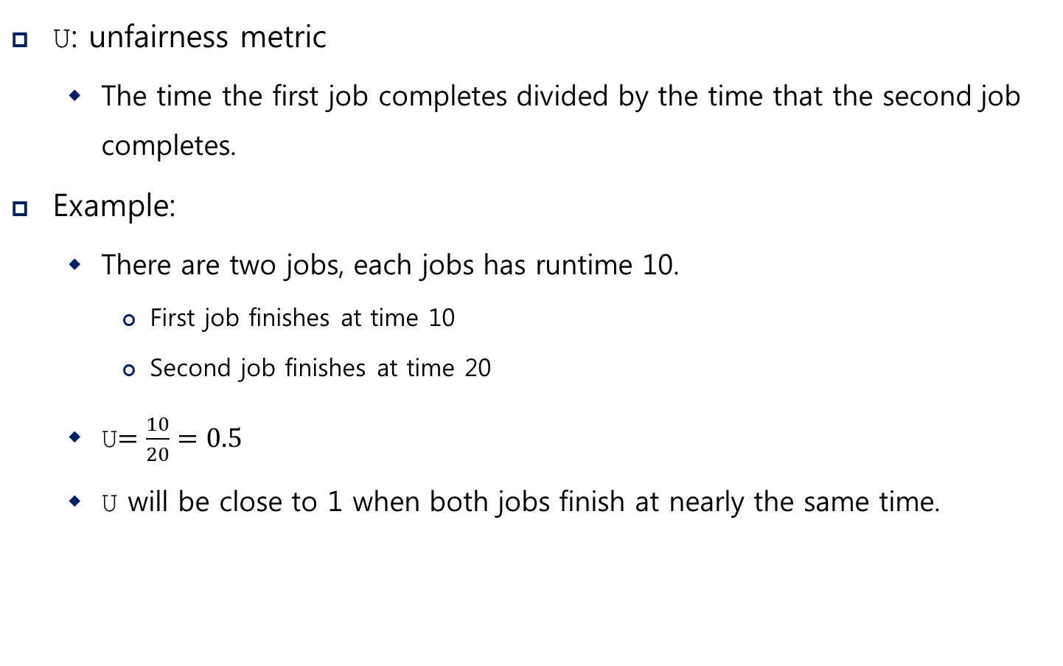
Where Are Page Tables Stored?
Page tables can get awfully large
32-bit address space with 4-KB pages, 20 bits for VPN
${4MB= 2}^{20} entries ∗4 Bytes per page table entry$
Page tables for peach process are stored in memory.

Slide 49
Example: Page Table in Kernel Physical Memory
0
page table
3 7 5 2
page frame 0 of physical memory
16
(unused)
page frame 1
32
page 3 of AS
page frame 2
48
page 0 of AS
page frame 3
64
(unused)
page frame 4
80
page 2 of AS
page frame 5
96
(unused)
page frame 6
112
page 1 of AS
page frame 7
128
Physical Memory

Slide 50
What Is In The Page Table?
The page table is just a data structure that is used to map the virtual address to physical address.
Simplest form: a linear page table, an array
The OS indexes the array by VPN, and looks up the page-table entry.

Slide 51
Common Flags Of Page Table Entry
Valid Bit: Indicating whether the particular translation is valid.
Protection Bit: Indicating whether the page could be read from, written to, or executed from
Present Bit: Indicating whether this page is in physical memory or on disk(swapped out)
Dirty Bit: Indicating whether the page has been modified since it was brought into memory
Reference Bit (Accessed Bit): Indicating that a page has been accessed

Slide 52
Example: x86 Page Table Entry
31 | 30 | 29 | 28 | 27 | 26 | 25 | 24 | 23 | 22 | 21 | 20 | 19 | 18 | 17 | 16 | 15 | 14 | 13 | 12 | 11 | 10 | 9 | 8 | 7 | 6 | 5 | 4 | 3 | 2 | 1 | 0
P: present
R/W: read/write bit
U/S: supervisor
A: accessed bit
D: dirty bit
PFN: the page frame number
PFN
G
PAT
D
A
PCD
PWT
U/S
R/W
P
An x86 Page Table Entry(PTE)

Slide 53
Paging: Too Slow
To find a location of the desired PTE, the starting location of the page table is needed.
For every memory reference, paging requires the OS to perform one extra memory reference.

Slide 54
Accessing Memory With Paging
1 // Extract the VPN from the virtual address
2 VPN = (VirtualAddress & VPN_MASK) >> SHIFT
3
4 // Form the address of the page-table entry (PTE)
5 PTEAddr = PTBR + (VPN * sizeof(PTE))
6
7 // Fetch the PTE
8 PTE = AccessMemory(PTEAddr)
9
10 // Check if process can access the page
11 if (PTE.Valid == False)
12 RaiseException(SEGMENTATION_FAULT)
13 else if (CanAccess(PTE.ProtectBits) == False)
14 RaiseException(PROTECTION_FAULT)
15 else
16 // Access is OK: form physical address and fetch it
17 offset = VirtualAddress & OFFSET_MASK
18 PhysAddr = (PTE.PFN << PFN_SHIFT) | offset
19 Register = AccessMemory(PhysAddr)

Slide 55
A Memory Trace
Example: A Simple Memory Access
Compile and execute
Resulting Assembly code
int array[1000];
...
for (i = 0; i < 1000; i++)
array[i] = 0;
prompt> gcc –o array array.c –Wall –o
prompt>./array
0x1024 movl $0x0,(%edi,%eax,4)
0x1028 incl %eax
0x102c cmpl $0x03e8,%eax
0x1030 jne 0x1024

Slide 56
A Virtual (And Physical) Memory Trace
Page Table[39]
1224
1174
Page Table(PA)
Page Table[1]
1124
1074
1024
Array(VA)
40100
mov
7132
Array(PA)
40050
7282
40000
7232
Code(VA)
1124
mov
inc
cmp
jne
4196
Code(PA)
1074
4146
1024
4096
0
10
20
30
40
50
Memory Access

